Slide 1
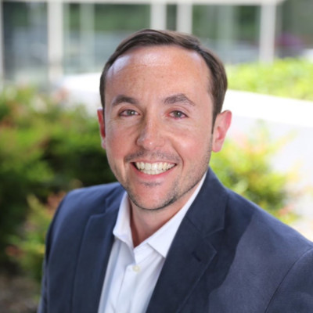
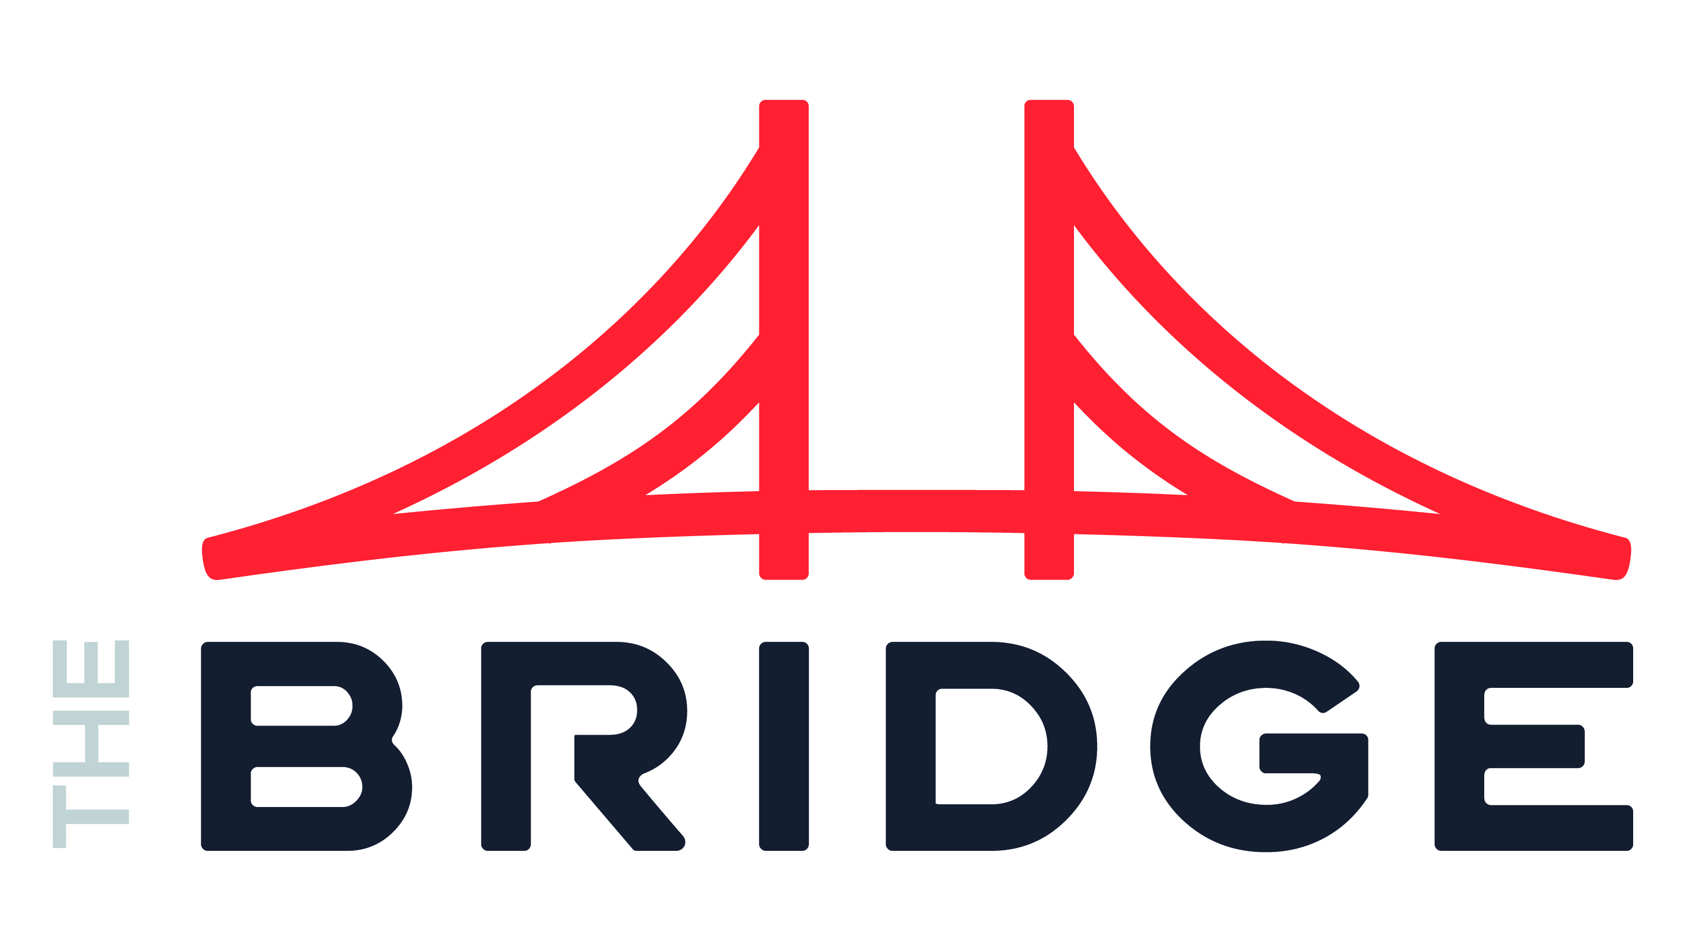
Jim Theologes Machine Learning and MLOps
INDUSTRIES
Industry Experience
Financial Services | Technology | Automotive | Healthcare | Hospitality | Retail | Airline | CPG
EXPERIENCE
Unified Data & ML Platform | Automotive
Strategic advisor and architect for AWS centric, in-house Unified Data and ML Platform designed to centralize all data sources into one platform for business analytics and machine learning use cases
Primary focus was on ingesting and transformation of large quantities of data and Machine Learning
Engineered solution using a combination of AWS Athena and Dask to create a data flattening process that reduced costs by 10-20x versus original setup in EMR
Created orchestration architecture for automated data processing using the above solution
Led discovery for client on alterative platforms that could replace current custom platform created in-house
Enterprise Data Library | Healthcare
Served as client lead and strategic advisor for implementation of an Enterprise Data Library combining various source systems into one centralized location for business users
Led team of 5 architects and engineers in development of the platform from 3 main sides: data ops, ML Ops and Infrastructure
Advised clients on best tools and platforms for creation of platform and worked with vendors to assist client with pricing and SME hours
Primary platforms were:
Starburst Data
Databricks
Azure
Azure
BACKGROUND
Functional Skills
Data Strategy, AI, Data Science, Data Leadership, Data Engineering, Organizational Effectiveness, Business Processes
Qualifications:
Consulting leader focused on Data & AI strategy and implementation. While focused on strategy for AI, Jim has served as lead architect for many new data systems including a Unified Data & ML Platform for an automotive client and an Enterprise Data Library for a Healthcare client as recent examples.
BIO & CONTACT INFO
Email
jim.theologes@thebridge.com
Mobile
(847) 409-6573
Location
DFW, Texas
Jim joined The Bridge in November 2023. He has previously worked at several technology consulting firms (both large and boutique) where has led advisory and implementation for AI & Machine Learning practices for a wide range of customers across many industries.

